Slide 1
10 First Principles
A set of guidelines for constructing more secure systems
Layering
Resource encapsulation
Abstraction
Modularity
Least privilege
Domain separation
Process isolation
Information hiding
Simplicity
Minimization

Slide 2
Camp activity
10 First Principles Bingo
After they are explained, identify where they appear in camp and fill out box with a description
Teams completing the card get some swag.

Slide 3

Layering
Organizing functions into discrete units
Cooking food, serving food, bussing tables, washing dishes

Slide 4
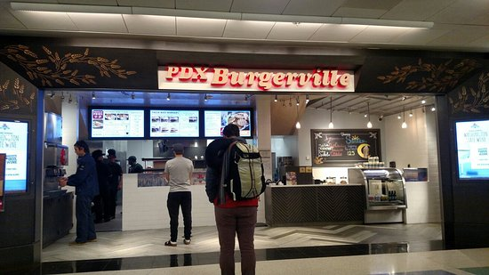
Resource encapsulation
Wrapping a function or data
Kitchen encapsulating the production of food

Slide 5
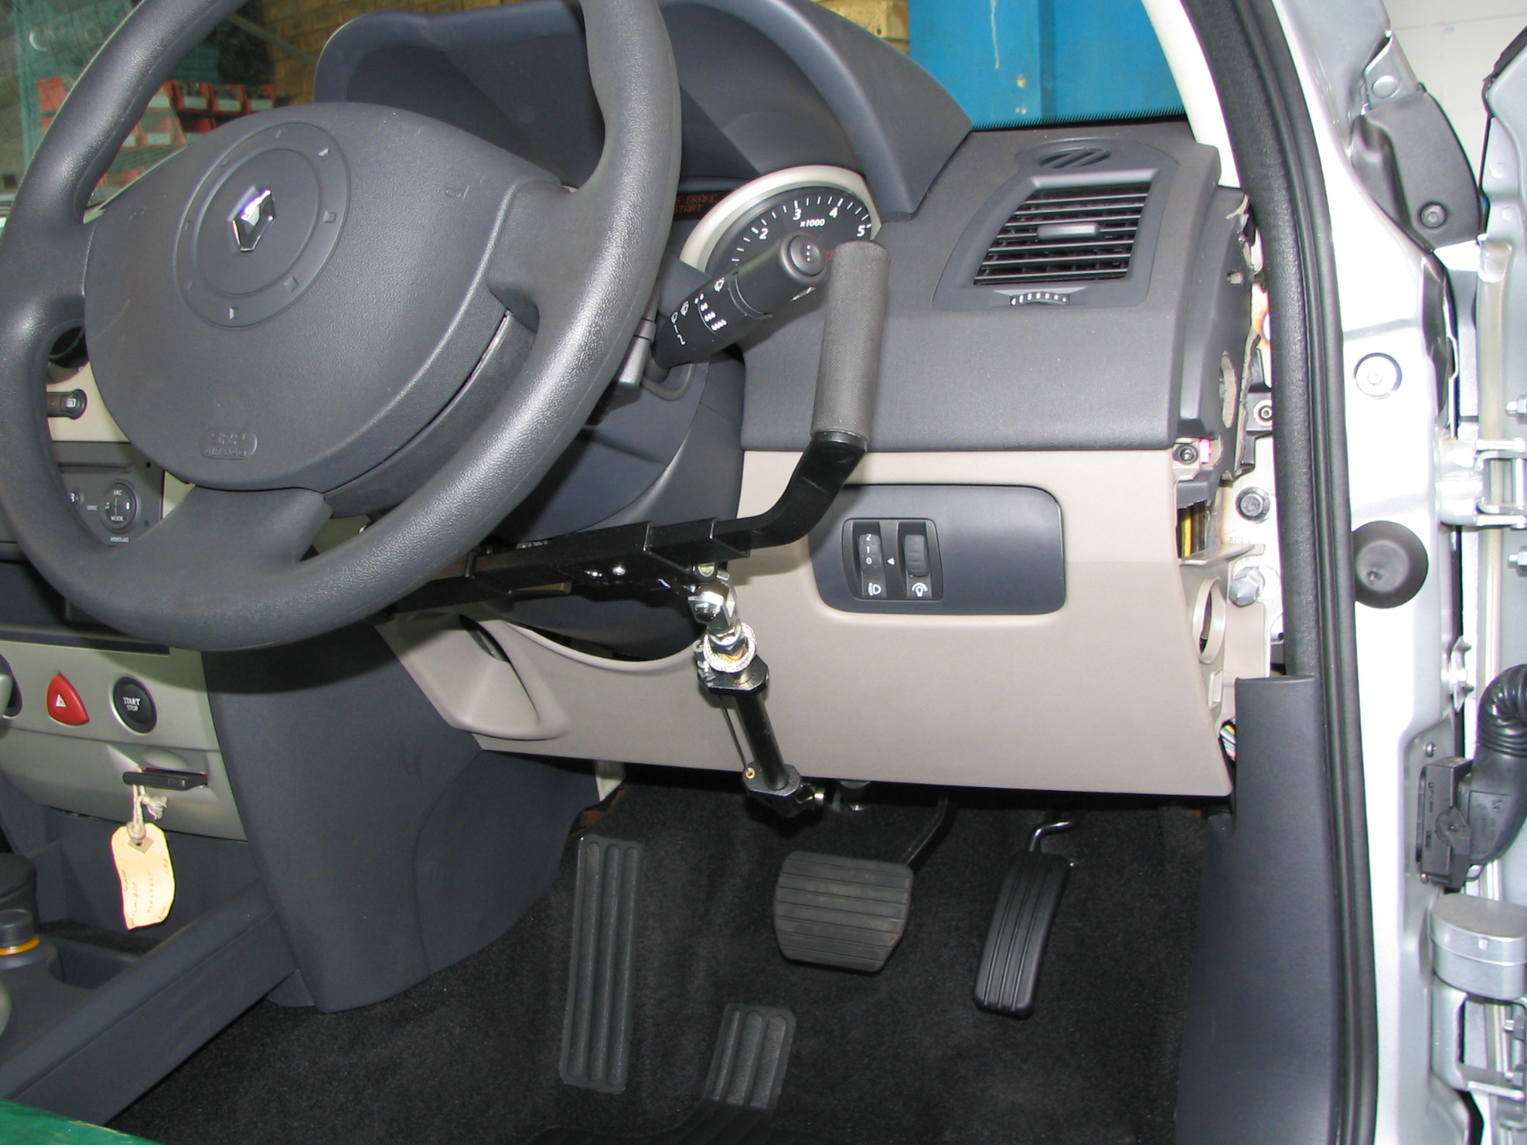
Abstraction
Wrapping the function of something with a simple interface
Steering wheel, accelerator, brake, ignition

Slide 6
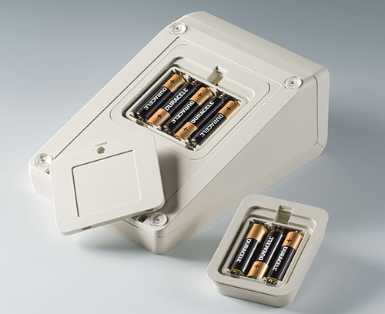
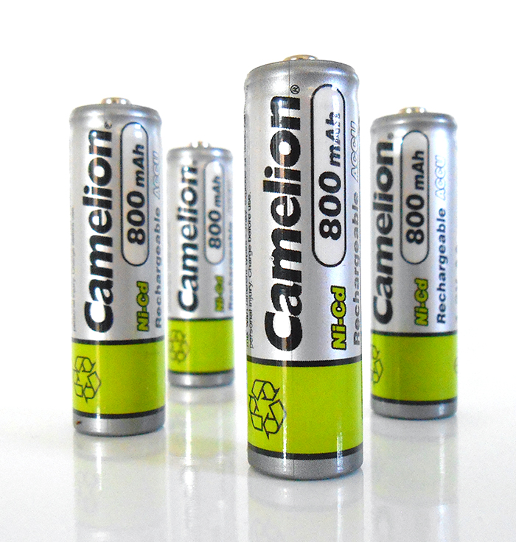
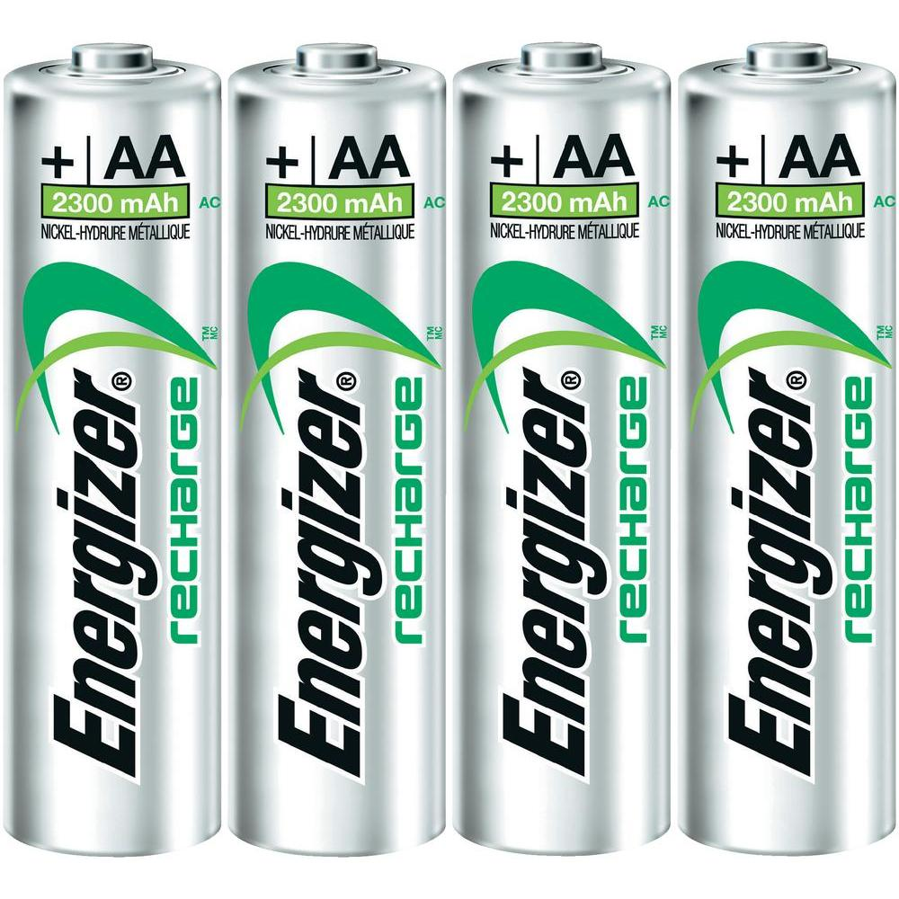
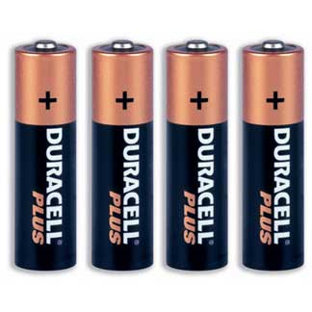
Modularity
Supporting interchangeability
Standardized batteries in electronics

Slide 7

Least privilege
Giving users only the privileges they need
Not giving administrator privileges to CEOs

Slide 8


Domain separation
Making sure users in two disparate organizations don’t get at each others’ stuff
Making sure the RNC and DNC can’t access each others’ stuff (in an ideal world, at least)

Slide 9
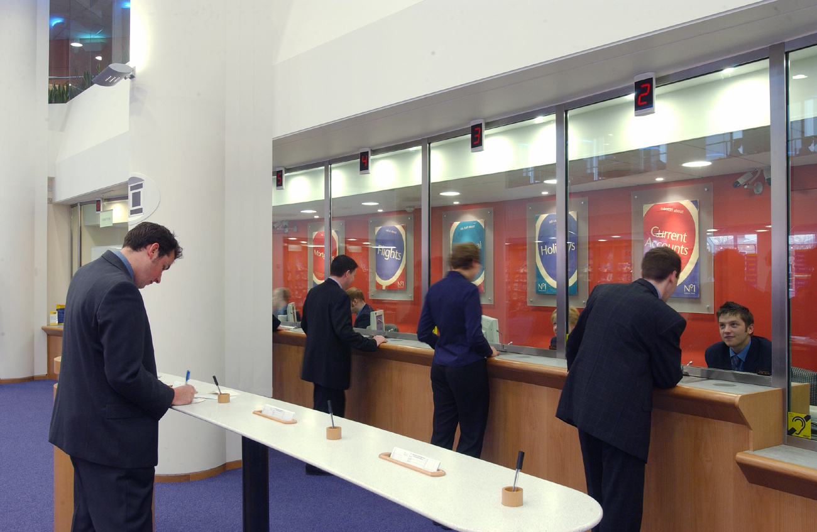
Process isolation
Making sure transactions and executions are separate
Bank tellers insuring no interaction between customer transactions

Slide 10
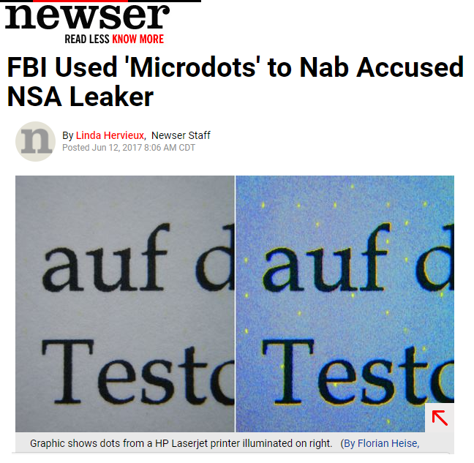
Information hiding
Scambling or concealing data
Imperceptible codes embedded by printers

Slide 11


Simplicity
Reducing complexity in design
Simplified UI for phones

Slide 12
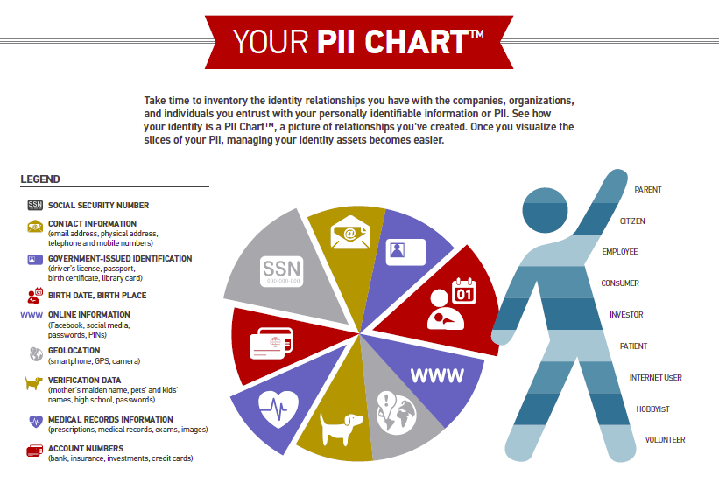
Minimization
Reducing the amount of code running and data collected
Only giving your SSNs when absolutely necessary

